Slide 1
Special functions and Integral Transforms MAT 241
Dr. Mohamed Adel
mohamed.adel@aiet.edu.eg

Slide 2
Lecture7: Fourier Transform

Slide 3

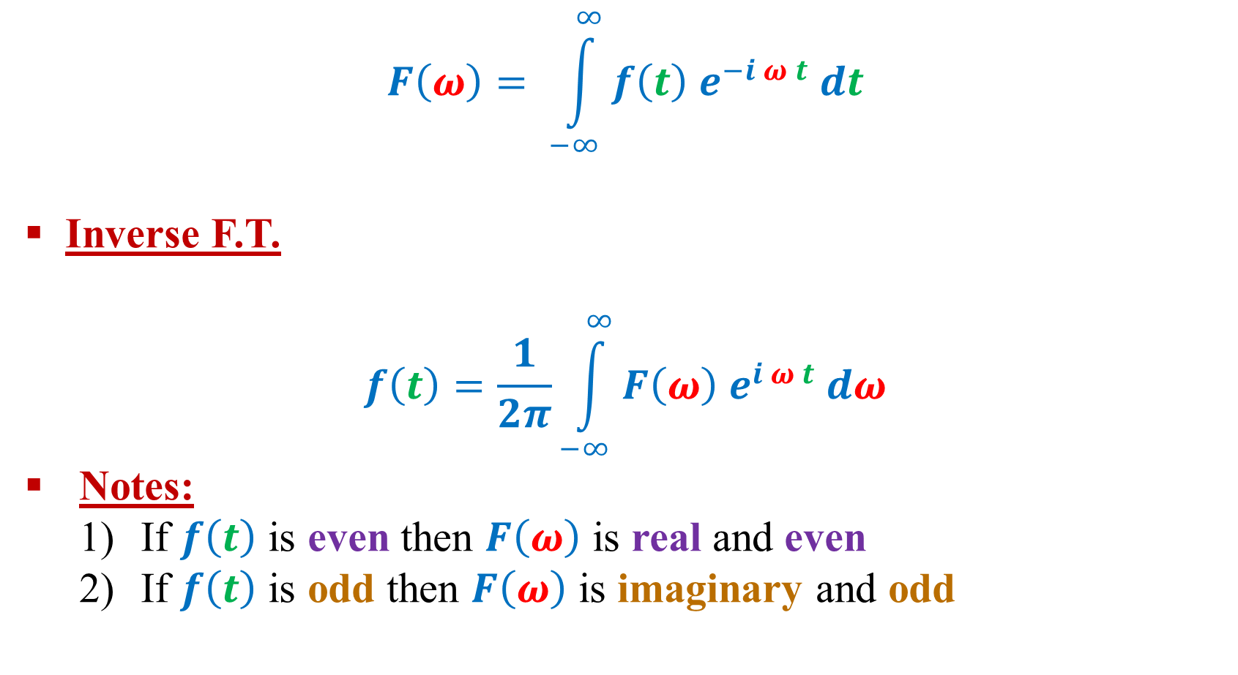
Fourier Transform:
$$F\left(ω\right)= \int_{−∞}^{∞}{f\left(t\right) e^{−i ω t} dt}$$
Inverse F.T.
$$f\left(t\right)=\frac{1}{2π}\int_{−∞}^{∞}{F\left(ω\right) e^{i ω t} dω}$$
Notes:
If $f\left(t\right)$ is even then $F\left(ω\right)$ is real and even
If $f\left(t\right)$ is odd then $F\left(ω\right)$ is imaginary and odd

Slide 4
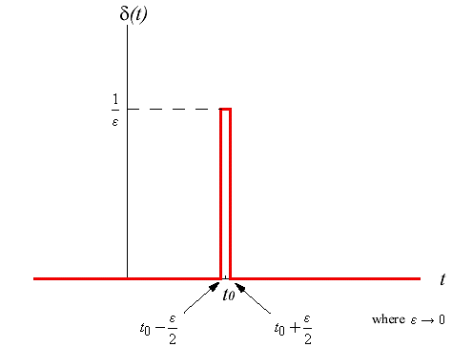
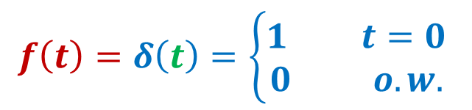
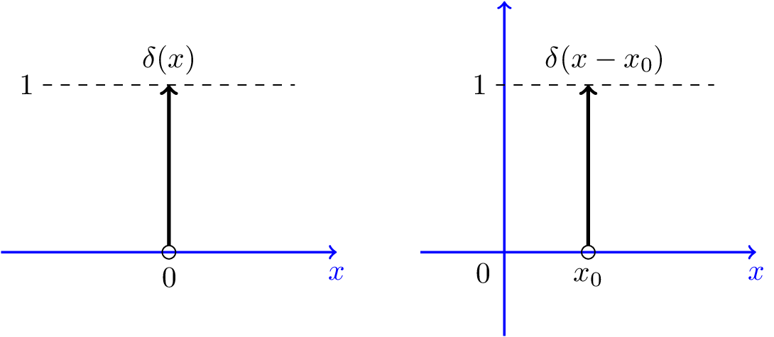
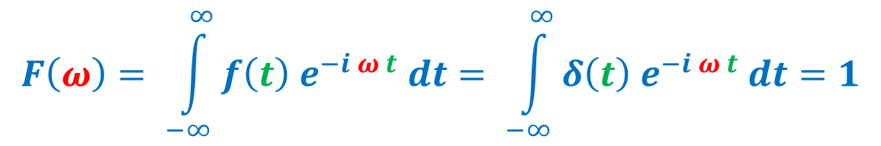
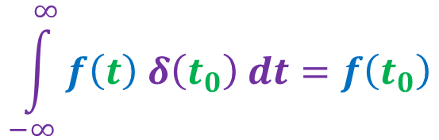
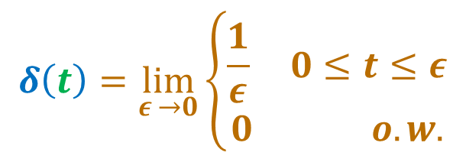
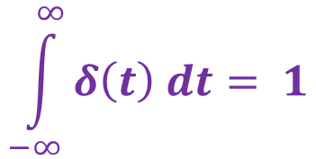
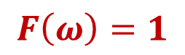
1) Unit Impulse Function:
$$f\left(t\right)=δ\left(t\right)=\left\{\begin{aligned}1 t=0 \\ 0 o.w.\end{aligned}\right.$$
$$δ\left(t\right)=\lim_{ε →0}\left\{\begin{aligned}\frac{1}{ε} 0≤t≤ε \\ 0 o.w.\end{aligned}\right.$$
$$\int_{−∞}^{∞}{δ\left(t\right) dt}= 1$$
Note that:
$$\int_{−∞}^{∞}{f\left(t\right) δ\left(t_{0}\right) dt}=f\left(t_{0}\right)$$
$$F\left(ω\right)= \int_{−∞}^{∞}{f\left(t\right) e^{−i ω t} dt}= \int_{−∞}^{∞}{δ\left(t\right) e^{−i ω t} dt}=1$$
$$F\left(ω\right)=1$$

Slide 5
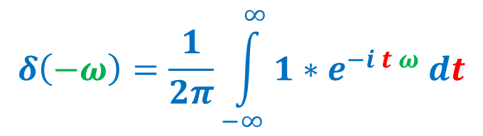

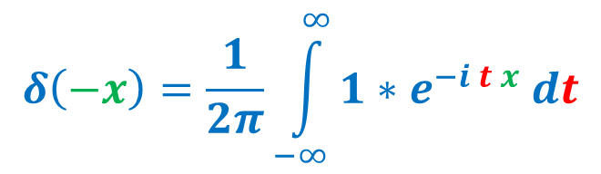
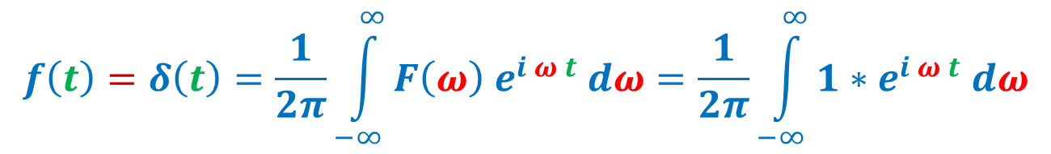
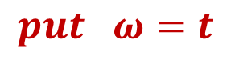
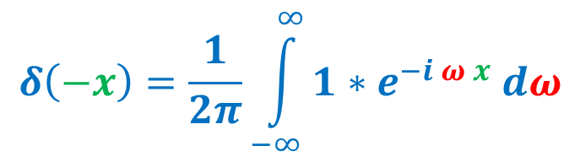

Note that:
$$F\left(ω\right)=1$$
$$f\left(t\right)=δ\left(t\right)=\frac{1}{2π}\int_{−∞}^{∞}{F\left(ω\right) e^{i ω t} dω}=\frac{1}{2π}\int_{−∞}^{∞}{1∗e^{i ω t} dω}$$
$$put t=−x$$
$$δ\left(−x\right)=\frac{1}{2π}\int_{−∞}^{∞}{1∗e^{−i ω x} dω}$$
$$put ω=t$$
$$δ\left(−x\right)=\frac{1}{2π}\int_{−∞}^{∞}{1∗e^{−i t x} dt}$$
$$δ\left(−ω\right)=\frac{1}{2π}\int_{−∞}^{∞}{1∗e^{−i t ω} dt}$$

Slide 6
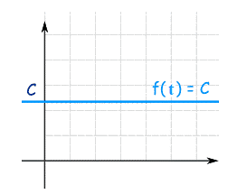
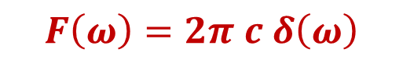
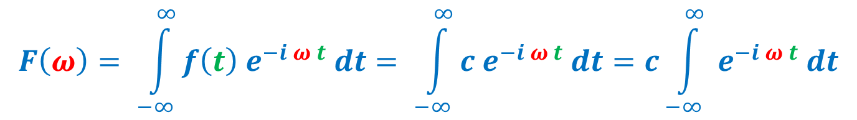
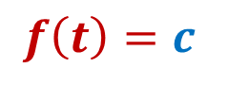
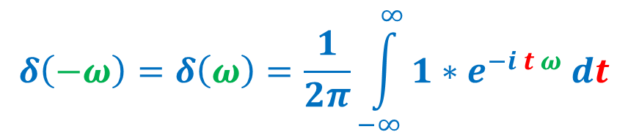
2) Constant Function:
$$f\left(t\right)=c$$
$$F\left(ω\right)= \int_{−∞}^{∞}{f\left(t\right) e^{−i ω t} dt}= \int_{−∞}^{∞}{c e^{−i ω t} dt}=c\int_{−∞}^{∞}{ e^{−i ω t} dt}$$
Note that:
$$δ\left(−ω\right)=δ\left(ω\right)=\frac{1}{2π}\int_{−∞}^{∞}{1∗e^{−i t ω} dt}$$
$$F\left(ω\right)=2π c δ\left(ω\right)$$

Slide 7
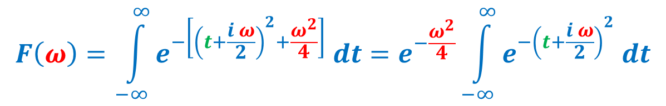
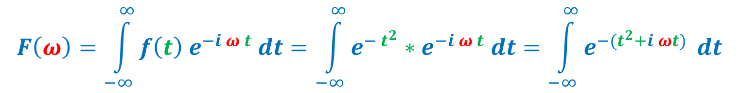
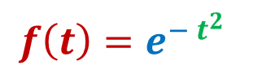
3) Error Function:
$$f\left(t\right)=e^{− t^{2}}$$
$$F\left(ω\right)=\int_{−∞}^{∞}{f\left(t\right) e^{−i ω t} dt}=\int_{−∞}^{∞}{e^{− t^{2}}∗e^{−i ω t} dt}=\int_{−∞}^{∞}{e^{−(t^{2}+i ωt) } dt}$$
Completing the square: $t^{2}+i ωt={\left(t+\frac{i ω}{2}\right)}^{2}−{\left(\frac{i ω}{2}\right)}^{2}={\left(t+\frac{i ω}{2}\right)}^{2}+\frac{ω^{2}}{4}$
$$F\left(ω\right)=\int_{−∞}^{∞}{e^{−\left[{\left(t+\frac{i ω}{2}\right)}^{2}+\frac{ω^{2}}{4}\right]} dt}=e^{−\frac{ω^{2}}{4}}\int_{−∞}^{∞}{e^{−{\left(t+\frac{i ω}{2}\right)}^{2}} dt}$$
Let: $t+i\frac{ω}{2}=x → dt=dx$

Slide 8
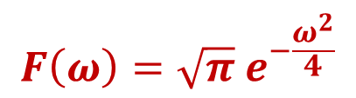
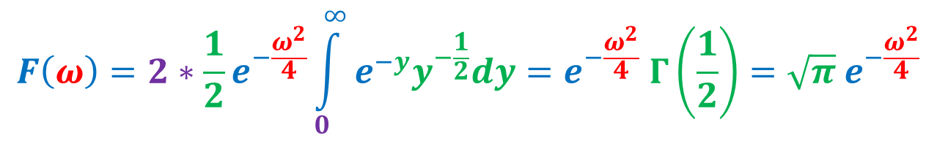
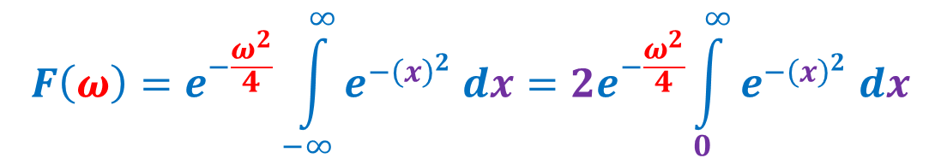
$$F\left(ω\right)=e^{−\frac{ω^{2}}{4}}\int_{−∞}^{∞}{e^{−{\left(x\right)}^{2}} dx}={2e}^{−\frac{ω^{2}}{4}}\int_{0}^{∞}{e^{−{\left(x\right)}^{2}} dx}$$
Put: $x^{2}=y → x=y^{\frac{1}{2}} → dx=\frac{1}{2} y^{−\frac{1}{2}}dy$
$$F\left(ω\right)={2∗\frac{1}{2}e}^{−\frac{ω^{2}}{4}}\int_{0}^{∞}{e^{−y}y^{−\frac{1}{2}}dy}=e^{−\frac{ω^{2}}{4}} Γ\left(\frac{1}{2}\right)=\sqrt{π} e^{−\frac{ω^{2}}{4}}$$
$$F\left(ω\right)=\sqrt{π} e^{−\frac{ω^{2}}{4}}$$
Note that the variation in both time and frequency domain are the same except for constant $\sqrt{π}$

Slide 9
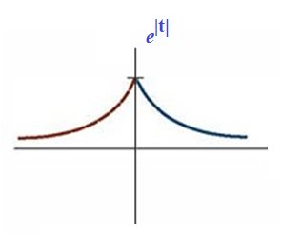
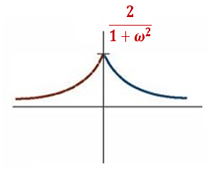
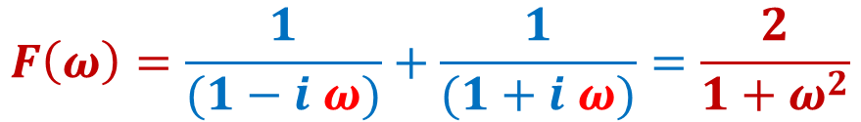
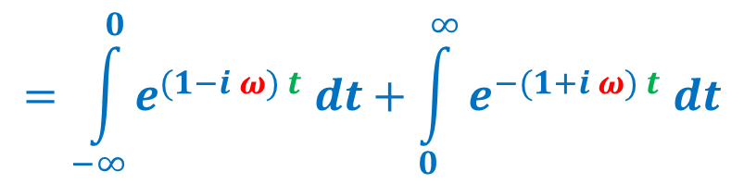
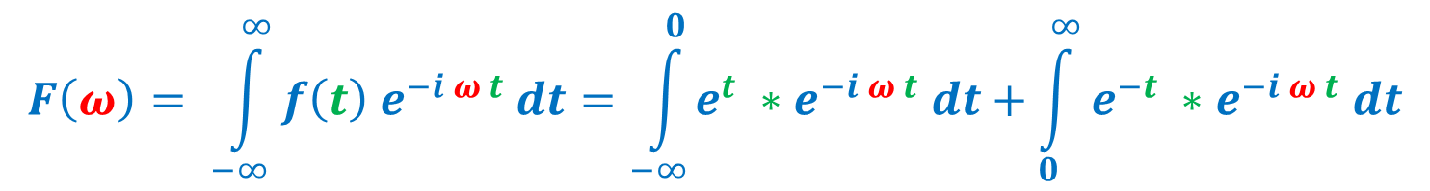
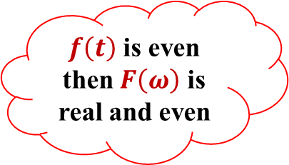
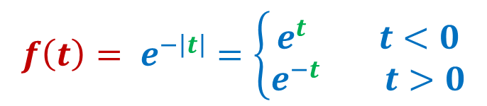
4) Decaying Exponential Function:
$$f\left(t\right)= e^{−\left|t\right|}=\left\{\begin{aligned}e^{t} t<0 \\ e^{−t} t>0\end{aligned}\right.$$
$$F\left(ω\right)= \int_{−∞}^{∞}{f\left(t\right) e^{−i ω t} dt}=\int_{−∞}^{0}{e^{t} ∗e^{−i ω t} dt}+\int_{0}^{∞}{e^{−t} ∗e^{−i ω t} dt}$$
$f\left(t\right)$ is even then $F\left(ω\right)$ is real and even
$$=\int_{−∞}^{0}{e^{(1−i ω) t} dt}+\int_{0}^{∞}{e^{−(1+i ω) t} dt}$$
$$F\left(ω\right)=\frac{1}{(1−i ω)}+\frac{1}{(1+i ω)}=\frac{2}{1+ω^{2}}$$

Slide 10
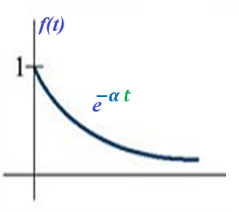
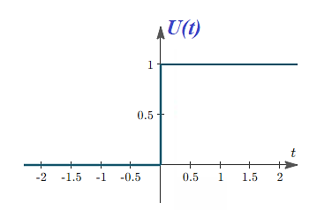
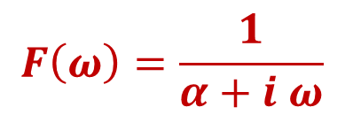
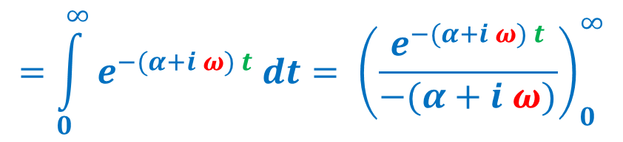
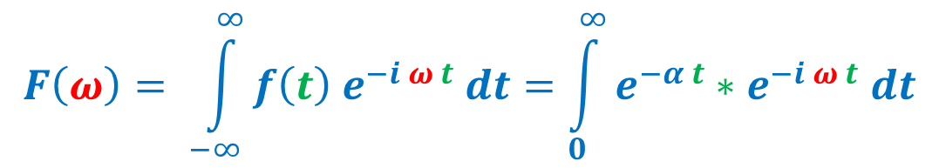
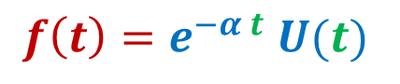
5) Right Side Decaying exponential:
$$f\left(t\right)=e^{−α t} U(t)$$
$$F\left(ω\right)= \int_{−∞}^{∞}{f\left(t\right) e^{−i ω t} dt}=\int_{0}^{∞}{e^{−α t}∗e^{−i ω t} dt}$$
$$=\int_{0}^{∞}{e^{−(α+i ω) t} dt}= {\left(\frac{e^{−(α+i ω) t}}{−(α+i ω)}\right)}_{0}^{∞}$$
$$F\left(ω\right)=\frac{1}{α+i ω}$$

Slide 11
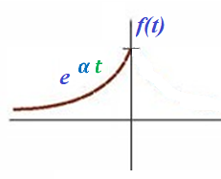
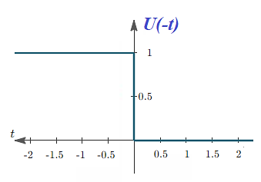
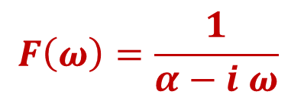
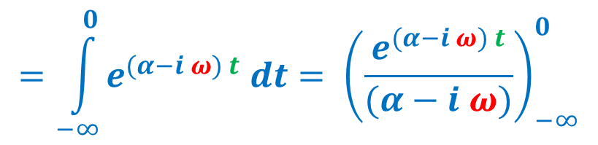
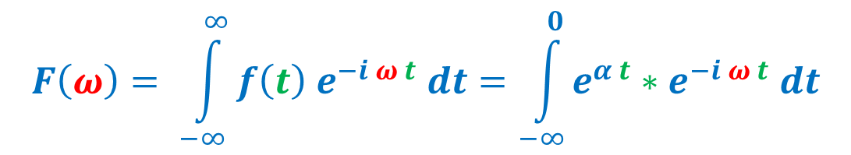
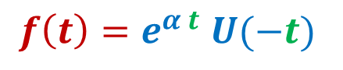
6) Left Side Decaying exponential:
$$f\left(t\right)=e^{α t} U(−t)$$
$$F\left(ω\right)= \int_{−∞}^{∞}{f\left(t\right) e^{−i ω t} dt}=\int_{−∞}^{0}{e^{α t}∗e^{−i ω t} dt}$$
$$=\int_{−∞}^{0}{e^{(α−i ω) t} dt}= {\left(\frac{e^{(α−i ω) t}}{(α−i ω)}\right)}_{−∞}^{0}$$
$$F\left(ω\right)=\frac{1}{α−i ω}$$

Slide 12
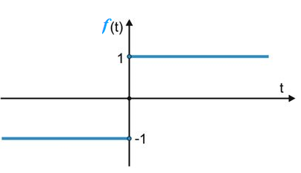
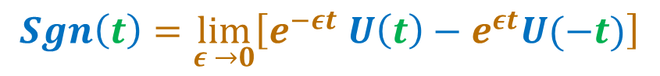
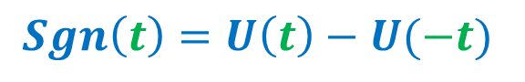
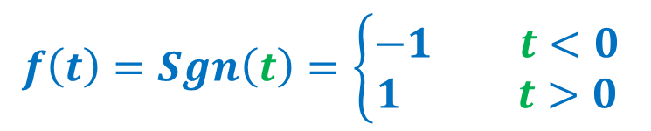
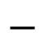
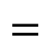
7) Signum Function:
$$=$$
$$−$$
$$f\left(t\right)=Sgn\left(t\right)=\left\{\begin{aligned}−1 t<0 \\ 1 t>0\end{aligned}\right.$$
$$Sgn\left(t\right)=U\left(t\right)−U(−t)$$
$$Sgn\left(t\right)=\lim_{ε →0}\left[e^{−εt} U\left(t\right)−e^{εt}U(−t)\right]$$

Slide 13




$$F\left(ω\right)=F.T. \left\{\lim_{ε →0}\left[e^{−εt} U\left(t\right)−e^{εt}U(−t)\right]\right\}$$
$$F\left(ω\right)=\lim_{ε →0}\left[F.T. \left\{e^{−εt} U\left(t\right)\right\}−F.T.\{e^{εt}U\left(−t\right)\}\right]$$
$$F\left(ω\right)=\lim_{ε →0}\left[\frac{1}{ε+iω}−\frac{1}{ε−iω}\right]=\frac{1}{iω}−\frac{1}{−iω}=\frac{2}{iω}$$
$f\left(t\right)$ is odd then $F\left(ω\right)$ is imaginary and odd
$$F\left(ω\right)=\frac{2}{iω}$$

Slide 14





8) Rectangular Pulse:
$$f\left(t\right)=Rec \left(t\right)=\left\{\begin{aligned}1 −1≤t≤1 \\ 0 o.w.\end{aligned}\right.$$
$$F\left(ω\right)= \int_{−∞}^{∞}{f\left(t\right) e^{−i ω t} dt}= \int_{−1}^{1}{1 e^{−i ω t} dt}=\frac{e^{iω}−e^{−iω}}{ω}=\frac{2 sin (ω)}{ω}$$
$$F\left(ω\right)=\frac{2 sin (ω)}{ω}=2 sinc (ω)$$

Slide 15




9) Triangular Pulse:
$$f\left(t\right)=tri\left(t\right)=\left\{\begin{aligned}1−t t>0 \\ 1+t t<0\end{aligned}\right.$$
$$F\left(ω\right)= \int_{−∞}^{∞}{f\left(t\right) e^{−i ω t} dt}=\int_{−∞}^{∞}{f\left(t\right) \left(cos \left(ω t\right)−i sin \left(ω t\right)\right)dt}$$
Note that: f(t) is even function then
$$F\left(ω\right)=2\int_{0}^{∞}{f\left(t\right) \left(cos \left(ω t\right)\right)dt}$$

Slide 16






$$F\left(ω\right)=2\int_{0}^{∞}{f\left(t\right) \left(cos \left(ω t\right)\right)dt}=2\int_{0}^{∞}{\left(1−t\right) \left(cos \left(ω t\right)\right)dt}$$
$$F\left(ω\right)=2{\left[\left(1−t\right)\frac{sin\left(ω t\right)}{ω}−\frac{cos \left(ω t\right)}{ω^{2}}\right]}_{0}^{1}$$
$$F\left(ω\right)=2\left(\frac{1−cos \left(ω \right)}{ω^{2}}\right)$$
$$\cos\left(2θ\right)=1−2 \sin^{2}θ$$
$$F\left(ω\right)=2\left(\frac{1−\left(1−2 \sin^{2}\left(\frac{ω}{2}\right)\right) }{ω^{2}}\right)=\frac{\left( \sin^{2}\left(\frac{ω}{2}\right)\right) }{{(\frac{ω}{2})}^{2}}$$
$$F\left(ω\right)=\frac{\left( \sin^{2}\left(\frac{ω}{2}\right)\right) }{{(\frac{ω}{2})}^{2}}$$

Slide 17



Slide 18

Summery of F.T. of important functions
$$f\left(t\right)$$ | $$F\left(ω\right)$$
$$δ\left(t\right)$$ | $$1$$
c | $$2π c δ\left(ω\right)$$
$$e^{− t^{2}}$$ | $$\sqrt{π} e^{−\frac{ω^{2}}{4}}$$
$$e^{−\left|t\right|}$$ | $$\frac{2}{1+ω^{2}}$$
$$e^{−α t} U(t)$$ | $$\frac{1}{α+i ω}$$
$$e^{α t} U(−t)$$ | $$\frac{1}{α−i ω}$$
$$Sgn\left(t\right)$$ | $$\frac{2}{iω}$$
$$Rec \left(t\right)$$ | $$2 sinc (ω)$$
$$tri\left(t\right)$$ | $$\frac{\left( \sin^{2}\left(\frac{ω}{2}\right)\right) }{{(\frac{ω}{2})}^{2}}$$

Slide 19
Fourier Transform Properties

Slide 20




1) Linearity:
$$F.T. \left\{f_{1}\left(t\right)\right\}= F_{1}\left(ω\right)$$
$$F.T. \left\{f_{2}\left(t\right)\right\}= F_{2}\left(ω\right)$$
$$F.T. \left\{Af_{1}\left(t\right)+Bf_{2}\left(t\right)\right\}=A{ F}_{1}\left(ω\right)+B F_{2}\left(ω\right)$$
2) Scaling:
$$F.T. \left\{f\left(t\right)\right\}=F\left(ω\right)$$
$$F.T. \left\{f\left(a t\right)\right\}=\frac{1}{\left|a\right|}F\left(\frac{ω}{a}\right)$$

Slide 21

Example:
$F.T. \left\{e^{−3\left|t\right|}\right\}$
$$F.T. \left\{e^{−\left|t\right|}\right\}=\frac{2}{1+ω^{2}}$$
$$F.T. \left\{e^{−3\left|t\right|}\right\}=\frac{1}{3}\frac{2}{1+{(\frac{ω}{3})}^{2}}=\frac{6}{9+ω^{2}}$$
2) $F.T. \left\{e^{−2t^{2}}\right\}$
$$F.T. \left\{e^{−t^{2}}\right\}=\sqrt{π} e^{−\frac{ω^{2}}{4}}$$
$$F.T. \left\{e^{−{(\sqrt{2}t)}^{2}}\right\}=\frac{1}{\sqrt{2}}\sqrt{π} e^{−\frac{{(\frac{ω}{\sqrt{2}})}^{2}}{4}}=\sqrt{\frac{π}{2}}e^{−\frac{ω^{2}}{8}}$$

Slide 22

3) $F.T. \left\{δ\left(2t\right)\right\}$
$$F.T. \left\{δ\left(t\right)\right\}=1$$
$F.T. \left\{δ\left(2t\right)\right\}=\frac{1}{2} ∗1=\frac{1}{2}$
4) $F.T. \left\{sgn(−5t)\right\}$
$$F.T. \left\{sgn(t)\right\}=\frac{2}{iω}$$
$$F.T. \left\{sgn(−5t)\right\}=\frac{1}{5}\frac{2}{i(\frac{ω}{−5})}=\frac{2i}{ω}$$

Slide 23



3) Time Shift:
$$F.T. \left\{f\left(t\right)\right\}=F\left(ω\right)$$
$$F.T. \left\{f\left(t±a\right)\right\}=F\left(ω\right) e^{±i ω a}$$
Proof:
$$F.T. \left\{f\left(t±a\right)\right\}= \int_{−∞}^{∞}{f\left(t±a\right) e^{−i ω t} dt}$$
Put $t±a=x$ and $dt=dx$ $t=x∓a$
$$F.T. \left\{f\left(t±a\right)\right\}= \int_{−∞}^{∞}{f\left(x\right) e^{−i ω \left(x∓a\right)} dx}$$
$$F.T. \left\{f\left(t±a\right)\right\}= \int_{−∞}^{∞}{f\left(x\right) e^{−i ωx}e^{−i ω \left(∓a\right)} dx}=e^{±i ω a}\int_{−∞}^{∞}{f\left(x\right) e^{−i ωx} dx}$$

Slide 24

Example:
$F.T. \left\{e^{−\left|2t−3\right|}\right\}$
Note that:
The order to solve problem using properties is
1) Linearity 2) Scaling 3) Time shift
$$F.T. \left\{e^{−\left|t\right|}\right\}=\frac{2}{1+ω^{2}}$$
$$F.T. \left\{e^{−2\left|t\right|}\right\}=\frac{1}{2}\frac{2}{1+{(\frac{ω}{2})}^{2}}=\frac{4}{4+ω^{2}}$$
$$F.T. \left\{e^{−\left|2t−3\right|}\right\}=F.T. \left\{e^{−2\left|t−\frac{3}{2}\right|}\right\}=\frac{4}{4+ω^{2}}e^{−i\frac{3ω}{2}}$$

Slide 25

Example:
$F.T. \left\{e^{−t^{2}+2t}\right\}$
$$F.T. \left\{e^{−t^{2}+2t}\right\}=F.T. \left\{e^{−{\left(t−1\right)}^{2}+1}\right\}=F.T. \left\{e^{−{\left(t−1\right)}^{2}}e\right\}=e∗F.T. \left\{e^{−{\left(t−1\right)}^{2}}\right\}$$
$$F.T. \left\{e^{− t^{2}}\right\}=\sqrt{π} e^{−\frac{ω^{2}}{4}}$$
$$F.T. \left\{e^{−{\left(t−1\right)}^{2}}\right\}=\sqrt{π} e^{−\frac{ω^{2}}{4}}e^{−iω}$$
$$F\left(ω\right)=e∗\sqrt{π} e^{−\frac{ω^{2}}{4}}e^{−iω}$$

Slide 26


4) Frequency Shift:
$$F.T. \left\{f\left(t\right)\right\}=F\left(ω\right)$$
$$F.T. \left\{f\left(t\right)e^{i at}\right\}=F\left(ω−a\right)$$
Proof:
$$F.T. \left\{f\left(t\right)e^{i at}\right\}= \int_{−∞}^{∞}{f\left(t\right)e^{i at}e^{−i ω t} dt}$$
$$F.T. \left\{f\left(t\right)e^{i at}\right\}= \int_{−∞}^{∞}{f\left(t\right) e^{−i (ω−a) t} dt}$$
$$\int_{−∞}^{∞}{f\left(t\right) e^{−i (ω−a) t} dt}=F\left(ω−a\right)$$

Slide 27

Example:
$F.T. \left\{e^{−2\left|t−1\right|}e^{i 4t}\right\}$
Note that:
The order to solve problem using properties is
1) Linearity 2) Scaling 3) Time shift 4) Frequency shift
$$F.T. \left\{e^{−\left|t\right|}\right\}=\frac{2}{1+ω^{2}}$$
$$F.T. \left\{e^{−2\left|t\right|}\right\}=\frac{1}{2}\frac{2}{1+{(\frac{ω}{2})}^{2}}=\frac{4}{4+ω^{2}}$$
$$F.T. \left\{e^{−2\left|t−1\right|}\right\}=\frac{4}{4+ω^{2}}e^{−i ω}$$
$$F.T. \left\{e^{−2\left|t−1\right|}e^{i 4t}\right\}=\frac{4}{4+{(ω−4)}^{2}}e^{−i (ω−4)}$$

Slide 28

Example:
$F.T. \left\{cos \left(ω_{0}t\right)\right\}$
$$F.T. \left\{1\right\}=2π δ\left(ω\right)$$
$$cos \left(ω_{0}t\right)=\frac{e^{iω_{0}t}+e^{−iω_{0}t}}{2}$$
$$F.T. \left\{cos \left(ω_{0}t\right)\right\}=\frac{1}{2}F.T. \left\{e^{iω_{0}t}+e^{−iω_{0}t}\right\}$$
$$F.T. \left\{cos \left(ω_{0}t\right)\right\}=\frac{1}{2}\left(2π δ\left(ω+ω_{0}\right)+2π δ\left(ω−ω_{0}\right)\right)$$
$$F.T. \left\{cos \left(ω_{0}t\right)\right\}=π\left(δ\left(ω+ω_{0}\right)+δ\left(ω−ω_{0}\right)\right)$$

Slide 29

Example:
$F.T. \left\{sin \left(ω_{0}t\right)\right\}$
$$F.T. \left\{1\right\}=2π δ\left(ω\right)$$
$$sin \left(ω_{0}t\right)=\frac{e^{iω_{0}t}−e^{−iω_{0}t}}{2i}$$
$$F.T. \left\{sin\left(ω_{0}t\right)\right\}=\frac{1}{2i}F.T. \left\{e^{iω_{0}t}−e^{−iω_{0}t}\right\}$$
$$F.T. \left\{sin\left(ω_{0}t\right)\right\}=\frac{1}{2i}\left(2π δ\left(ω−ω_{0}\right)−2π δ\left(ω+ω_{0}\right)\right)$$
$$F.T. \left\{sin\left(ω_{0}t\right)\right\}=\frac{π}{i}\left(δ\left(ω−ω_{0}\right)−δ\left(ω+ω_{0}\right)\right)$$

Slide 30



5) Duality (Symmetry) Property:
$$F.T. \left\{f\left(t\right)\right\}⟺F(ω)$$
$$F.T. \left\{F\left(t\right)\right\}⟺2π f(−ω)$$
Proof:
$${F.T.}^{−1}\left\{F(ω)\right\}=f\left(t\right)=\frac{1}{2π}\int_{−∞}^{∞}{F\left(ω\right) e^{i ω t} dω}$$
Replace $t by −t$in both sides
$$f\left(−t\right)=\frac{1}{2π}\int_{−∞}^{∞}{F\left(ω\right) e^{−i ω t} dω}$$

Slide 31

Replace$ω by x$in both sides
$$f\left(−t\right)=\frac{1}{2π}\int_{−∞}^{∞}{F\left(x\right) e^{−i x t} dx}$$
Replace $t by ω$in both sides
$$2π f\left(−ω\right)=\int_{−∞}^{∞}{F\left(x\right) e^{−i x ω} dx}$$
$$2π f\left(−ω\right)=F.T. \left\{F\left(x\right)\right\}$$
$$2π f\left(−ω\right)=F.T. \left\{F\left(t\right)\right\}$$

Slide 32






Example:
$F.T. \left\{\frac{1}{1+t^{2}}\right\}$
$$F.T. \left\{e^{−\left|t\right|}\right\}=\frac{2}{1+ω^{2}}$$
$$F.T. \left\{\frac{1}{1+t^{2}}\right\}=π e^{−\left|ω\right|}$$
$$2π$$
$$ω →t$$
$$t →−ω$$
$$\frac{2}{1+t^{2}}$$
$$2π e^{−\left|ω\right|}$$

Slide 33








Example:
$F.T. \left\{\frac{1}{t}\right\}$
$$F.T. \left\{Sgn\left(t\right)\right\}=\frac{2}{iω}$$
$$2π$$
$$ω →t$$
$$t →−ω$$
$$\frac{2}{it}$$
$$2π Sgn\left(−ω\right)$$
$$F.T. \left\{\frac{1}{t}\right\}=i π Sgn\left(−ω\right)=−i π Sgn\left(ω\right)$$

Slide 34



Example:
$F.T. \left\{\frac{1}{t−3}\right\}$
Note that:
The order to solve problem using properties is
1) Symmetry 2) Time shift
$$F.T. \left\{\frac{1}{t}\right\}=−i π Sgn\left(ω\right)$$
$F.T. \left\{\frac{1}{t−3}\right\}=−i π Sgn\left(ω\right)e^{−i 3ω}$

Slide 35

Summery of F.T. Properties
Property | $$f\left(t\right)$$ | $$F\left(ω\right)$$
Linearity | $$Af_{1}\left(t\right)+Bf_{2}\left(t\right)$$ | $$A{ F}_{1}\left(ω\right)+B F_{2}\left(ω\right)$$
Scaling | $$f\left(a t\right)$$ | $$\frac{1}{\left|a\right|}F\left(\frac{ω}{a}\right)$$
Time Shift | $$f\left(t±a\right)$$ | $$F\left(ω\right) e^{±i ω a}$$
Frequency Shift | $$f\left(t\right)e^{i at}$$ | $$F\left(ω−a\right)$$
Duality | $$F\left(t\right)$$ | $$2π f(−ω)$$

